Slide 1
PANDA
(Perinatal Anxiety & Depression Australia)
Sayani, Michael and Kirby

Slide 2


Acknowledgment and Introduction
Artwork by Sarrita King
Notes:
Hello, we would like to start this presentation off by acknowledging The Wurundjeri people as traditional owners of this land. We would like to pay our respects to their Elders, past and present and traditional owners that may have not been formally recognized (First Peoples - State Relations, 2023).
There will be three sections of this presentation covered by each person of our group. In the first section of the presentation, I will be discussing the overview of PANDA and what the organization entails. For the second part of the Presentation Sayani will be going over the need for PANDA as a whole and the prevalence of the organization and to conclude Michael will be discussing an analysis of the service provided.

Slide 3
Overview – Aim and mission
PANDA is an acronym that is used for Perinatal Anxiety & Depression Australia
PANDA has been a running business for the last 40 years
Founded in 1983 by Two Australian women experiencing psychological symptoms
Committed to empowering, educating and supporting parents and families throughout the different stages of pregnancy for the first twelve months of a baby.
Notes:
In 1983, Two Australian women from Victoria had experienced the effects of postnatal depression and discovered that there was a need for support. They came together and created Perinatal Anxiety & Depression Australia (PANDA) for families that were affected by childbirth related psychological disorders such as anxiety, depression, psychosis, and suicidal ideation, PANDA has been an operating organization for 40 years (PANDA, 2023.).
PANDA has been committed to empowering, educating and supporting parents and families throughout the different stages of pregnancy for the first twelve months of a baby. PANDA’s main mission and Aim is to spread awareness and to cultivate a world where perinatal mental health is valued and understood.

Slide 4
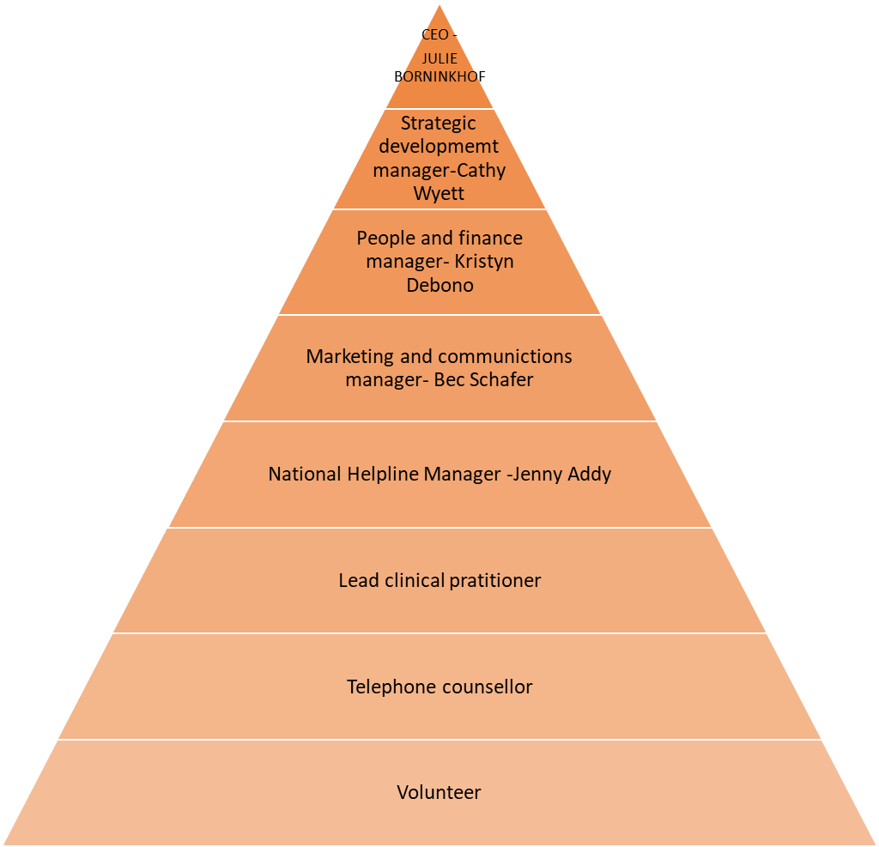
Staff
Chairperson – Ben Lannan
Treasurer- Matthew Stuart
Board Members-
Karen Marshmen, Kathi Boorman, Jenni Campbell, Ingrid Gotz and Amrita Ahluwalia
(Working at PANDA | PANDA, 2023)
Pyramid (Brahme, 2022,as sited in No rules rules,2020)
Notes:
PANDA works on performing and maintaining an image that respected and valued in the eye of the public. There is a board of directors which helps govern and maintain all the responsibilities within the organization such as overseeing financial performance, policy, and procedures and managing stakeholders (Duties and Responsibilities of Boards and Board Directors | boards.vic.gov.au, 2022.). Panda also values being a diverse workplace where inclusive practices are encouraged. You can work as a lead clinical practitioner, telephone counsellor or a volunteer(Working at PANDA | PANDA, 2023.).

Slide 5
Funding
Coporate supporters- Baby Bunting, The Priceline sisterhood foundation and Mustela.
Government supporters- Australian Department of Health, Victorian Department of family fairness and housing, Victorian state department of education.
Notes:
The supporters of PANDA help keep the organization running and readily available to the community. Some corporate supporters of PANDA include Baby Bunting, the Priceline Sisterhood foundation and Mustela. There is also Government support including the Australian Department of Health, Victorian department of family fairness and housing and the Victorian state department of education(PANDA Partners and Supporters | PANDA, n.d.). just to name a few.

Slide 6
Strengths of the company
Australia’s only National Helpline that supports expecting and new parents affected by perinatal mental illness in communities.
Health care provider training
Secondary consultations
Clinical Champions Program
Community Education
Notes:
Some strengths that PANDA has as an organization can be contributed to their passion in helping communities achieve goals. PANDA operates as Australia’s only national helpline for families and can provide counselling and information regarding perinatal mental health issues (About PANDA | PANDA, n.d.). Along with the helpline panda offers a range of programs and services such as secondary consultations from health care providers with special focus on perinatal mental health. A community champions program which is a network that is mainly volunteers that support families in a positive way to transition into early parenthood, there is also a clinical champions program which is dedicated to help support Mental Health in the perinatal period and last but not least PANDA also offers an educational program that helps with running activities to raise awareness of perinatal mental health in emerging parental groups and other community settings (About PANDA | PANDA, n.d.).

Slide 7
Need For The Organisation - defining the issue and prevalence
Sayani
The main issue that are addressed by PANDA is the mental health of new and expecting parents (PANDA 2023)
Focuses on the period from the time of pregnancy to a year following birth (New South Wales Health 2021)
100,000 parents roughly manage perinatal ill health (Department of Health and Aged Care 2020)
1 in 7 mothers
1 in 10 fathers
Notes:
As stated, prior, PANDA stands for perinatal anxiety and depression Australia. The overarching issue that it addresses is the mental health of expecting and new parents. The organisation focuses on the levels and states of depression, anxiety and ill mental health families may experience prior, during and following the birth of a child. Perinatal mental health is based on the state of an individual's mental health from the time of the pregnancy to a year after childbirth.
Perinatal depression and anxiety are experienced by roughly 100,000 parents yearly. Following birth 1 in 7 mothers will experience perinatal ill-health as well as 1 in 10 mothers while pregnant. Expecting and new fathers can also experience perinatal depression and anxiety as well as emotional distress with 1 in 10 fathers having reported so.

Slide 8
Need For The Organisation - cause and link to theory
Sayani
Evolves from concerns and stresses regarding pregnancy and parenthood (BeyondBlue 2022)
Can and does affect all types of people (National Institute of Mental Health 2022)
A product of both environmental factors and genetics (National Institute of Mental Health 2022)
Family development theory works through established stages to understand development and progression (Cohen and Strong 2020)
A focus is placed on changes that occur through these stages. (Cohen and Strong 2020)
Notes:
Perinatal depression, anxiety or ill mental health stems for the concerns, anxieties and stresses of becoming a parent and having to experience pregnancy. When partners or an individual's makes the decision to begin a family there are significant changes that occur within the dynamics between partners as well as within oneself. Perinatal ill health can and does affect all kinds of people regardless of gender, race, income level, sexuality, age or culture. Due to this, it is important to note nothing an individual or family does will definitively cause perinatal depression or anxiety. It has largely been accepted within psychological and scientific research as a product of environmental factors and genetics (NIMH). There is also an understanding that the physical and psychological changes that occur for parents may affect their mental health as well as mood and feelings (beyondblue). Within family development theory, the process of beginning a family and having children establishes the first two of eight main stages families will work through as their relationships develop and progress (Cohen and Strong 2020). These are beginning family and childbearing family respectively. Family development theory focuses on the changes that occur within these stages and the potential variation that may be present as a result of timing and context these stages occur. Using this perspective, perinatal ill mental health is a result of natural progression through major life stages and is characterised by the response family members have with one another and the subsequent continuation and movement on from this stage. The change that occurs is a product of progression and natural in relation to families and development

Slide 9
Analysis of Service Michael
Available Services
Information Sources
Training, support and advice for HCPs
Bidirectional referral model
Bronfenbrenner's Model
Microsystem
Mesosystem
Exosystem
Promoting Health and Wellbeing of Families
Expecting a Baby (n.d.); Cohen & Strong (2014); Health Care Providers (n.d.)
Notes:
The services available through PANDA are primarily a source of information for new and expecting parents, in the form of articles, stories from other parents and care givers, and a national help line aimed at informing parents on how to manage perinatal depression together within the first 12 months of becoming a family.
Further support is also offered for Health Care Professionals in the form of training, advice and support on the signs and symptoms of what to look out for, tailored care options, and enabling parents to talk.
PANDAs focus through the offering of these services is to help families work towards tailored health care to meet the needs of new and expecting mothers and families. Their bidirectional referral model allows parents to either approach them directly for advice on where to start, or through referral from a GP depending on the family's needs.
From a child's perspective, the elements of Bronfenbrenner's Ecological model impacted by perinatal depression include:
Microsystem (Family, Health Care Providers such as GPs and counsellors)
Mesosystem (connecting families and health care providers through referrals from GPs and other HCPs)
Exosystem (extended family, Government agencies, Social Services)
In order to assist families with their overall health and wellbeing, the services on offer to parents aim to:
Breaking down constraints around guilt and stigma experienced by new parents.
Assist mothers and fathers with attachment and connection with the new member of the family.
Work through Anxiety, self care
Child development and meeting the needs of the child
Addressing experiences associated with the mother's physiological changes (changes in hormone levels, lower stamina, dehydration)
Understanding psychological changes (feelings of inadequacy, emotional distancing from her own mother, communication challenges with other members of the family)

Slide 10
Conclusion
Sayani
PANDA stands for Perinatal Anxiety and Depression Australia
Focus on families affected by psychological disorders
Prevalent issue within all kinds of families
Through family development theory the issue is a natural progression of stages
Analysis of PANDA shows the main targets of parents and various kinds of families
The importance of health care providers
Notes:
In conclusion, PANDA standing of perinatal anxiety and depression Australia has a focus on growing families that are affected by a varying range of psychological disorders. The issue is one that can affect all kinds of families and is something that occurs as a result of no ones fault. An understanding of perinatal ill-health can be viewed through the framework of family development theory and seen as the progression of the first two stages. An analysis of PANDA shows the copious amounts of advice and support avaliable targeted at a wide range of families. Some of services also include referral and recommendations to health care providers to families.
Overall, PANDA is a necessary and essential service that can have long lasting impacts on families throughout their lifetime.

Slide 11
References:
Kirby
About PANDA|PANDA (n.d.). . https://panda.org.au/about/about-panda
Brahme, S. (n.d.). Organization Tree vs Organization Pyramid. www.linkedin.com. https://www.linkedin.com/pulse/organization-tree-vs-pyramid-sarang-brahme/?trk=pulse-article_more-articles_related-content-card
Duties and responsibilities of boards and board directors | boards.vic.gov.au.(n.d.). . Retrieved May 8, 2023, from https://www.boards.vic.gov.au/duties-and-responsibilities-boards-and-board-directors
First Peoples - State Relations | First Peoples - State Relations. (n.d.). https://www.firstpeoplesrelations.vic.gov.au/
PANDA partners and supporters | PANDA. (n.d.). https://panda.org.au/about/panda-partners-and-supporters
Sarrita King ArtistBiography (n.d.). https://www.kateowengallery.com/artists/Sar89/Sarrita-King.htm
Working at PANDA | PANDA. (n.d.). https://panda.org.au/about/working-at-panda

Slide 12
References:
Sayani
BeyondBlue. (2022). Perinatal Depression.
Cohen, T.F., & Strong, B. (2020). Studying Marriages and Families. In T.F. Cohen, & B. Strong (Eds.), The Marriage and Family Experience: Intimate Relationships in a Changing Society (14th ed., pp.29-65). Wadsworth Cengage Learning.
Department of Health and Aged Care. (2020). $13.6 million to support the mental health of new and expectant parents. Commonwealth of Australia
National Institute of Mental Health. (2022). Perinatal Depression
New South Wales Health (2021) Signs and Symptoms of perinatal mental health issues. New South Wales Government
PANDA. (2023). PANDA Our Commitment

Slide 13
References: Michael
Cohen, T. F., & Strong, B. (2021). The marriage and family experience: Intimate relationships in a changing society (14th edition, student edition). Cengage.
Expecting a Baby. PANDA. (n.d.). Expecting a Baby
Health Care Providers. PANDA. (n.d.). Health Care Providers

